Slide 1

6G/B6G HAPS Networks
An Evolution with a Revolutionary Impact
Halim Yanıkömeroğlu
Systems and Computer Engineering
Carleton University
Ottawa, Canada
Acknowledgement: My research group + our collaborators

Slide 2
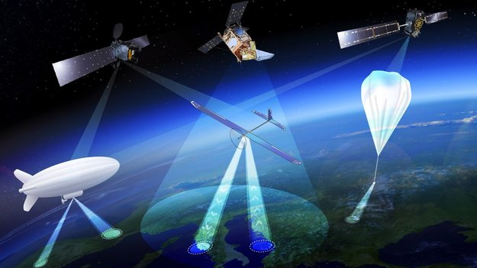
HAPS: High Altitude Platform Station (High Altitude Pseudo Satellite)
Article 1.66A of ITU’s Radio Regulations: “A station on an object at an altitude of 20 to 50 km
and at a specified, nominal, fixed point relative to the Earth". (1997)
Airship
Stratobus (Thales)
Balloon
Loon (Alphabet)
Fixed-wing aircraft
Zephry (Airbus)
Sunglider (HAPSMobile / Softbank)
SPL & CC (Deutsche Telecom)

Slide 3
HAPS/HIBS in ITU & 3GPP: Rural & Remote → Urban
ITU: WP5C Fixed Wireless Systems (satellites & HAPS) ||
WP5D IMT (Int’l Mobile Telecommunications) Systems (cellular)
WP5C Fixed Wireless Systems (satellites & HAPS) ||
WP5D IMT Systems (cellular & HIBS)
WRC-19 Resolution 247
HIBS: HAPS as an IMT BS
WRC-23 Agenda item 1.4
< 2.7 GHz harmonized with IMT

Slide 4
HAPS/HIBS in ITU & 3GPP: Rural & Remote → Urban
ITU: WP5C Fixed Wireless Systems (satellites & HAPS) ||
WP5D IMT (Int’l Mobile Telecommunications) Systems (cellular)
WP5C Fixed Wireless Systems (satellites & HAPS) ||
WP5D IMT Systems (cellular & HIBS)
3GPP: Terrestrial-satellite integration discussions
since early 1990s: 2G, 3G, 4G, 5G
NTN (satellites & HAPS=HIBS) || UAS
NTN (satellites) || HAPS=HIBS || UAS
WRC-19 Resolution 247
HIBS: HAPS as an IMT BS
WRC-23 Agenda item 1.4
< 2.7 GHz harmonized with IMT

Slide 5
HAPS Features
Scalable; no big upfront investment; can start with 1 HAPS, no need for 1000s of LEOs
Easy to launch (just an open field)
Deploy wherever necessary
Evolutionary; logical next level in multi-tier Vertical HetNets (VHetNets), easy integration
Owned by MNO, same/similar eco-system
xG cellular air-interface (no need for dedicated air-interface)
Geostationary
No tracking on the ground
No networking concerns (handoff, routing, addressing difficulties)
Closer to earth
Low latency
Low pathloss: Direct link to UE
Outdoors and indoors
mmWave up to 100 GHz (high rates)
Legislation-friendly; no data privacy concerns
No international agreements, regularity barriers, spectrum rights

Slide 6
Is HAPS like a GEO or LEO or Macro BS?
GEO
LEO
Higher area capacity
Lower pathloss (65 dB ↓)
Lower latency
(RTT: 239 ms → 133 μs)
HAPS
Macro BS

Slide 7
Is HAPS like a GEO or LEO or Macro BS?
GEO
LEO
Higher area capacity
Lower pathloss (65 dB ↓)
Lower latency
(RTT: 239 ms → 133 μs)
Higher area capacity
Lower pathloss (28 dB ↓)
Lower latency
(RTT: 3.33 ms → 133 μs)
Does not orbit
Much bigger size (real estate)
HAPS
Macro BS

Slide 8
Is HAPS like a GEO or LEO or Macro BS?
GEO
LEO
Higher area capacity
Lower pathloss (65 dB ↓)
Lower latency
(RTT: 239 ms → 133 μs)
Higher area capacity
Lower pathloss (28 dB ↓)
Lower latency
(RTT: 3.33 ms → 133 μs)
Does not orbit
Much bigger size (real estate)
HAPS
Macro BS
LOS
Bird’s-eye view of a large area
One-shot
Pathloss may be lower
Ex: (20,000 m)²/(1000 m)³ = 0.4
Ex:(20,000 m)²/(100 m)⁴ = 4

Slide 9
Is HAPS like a GEO or LEO or Macro BS?
GEO
LEO
Higher area capacity
Lower pathloss (65 dB ↓)
Lower latency
(RTT: 239 ms → 133 μs)
Higher area capacity
Lower pathloss (28 dB ↓)
Lower latency
(RTT: 3.33 ms → 133 μs)
Does not orbit
Much bigger size (real estate)
HAPS
Most things that GEO/LEO can do
can be achieved by HAPS (even better)
Macro BS
LOS
Bird’s-eye view of a large area
One-shot
Pathloss may be lower
Ex: (20,000 m)²/(1000 m)³ = 0.4
Ex:(20,000 m)²/(100 m)⁴ = 4
Most things that Macro BS can do
can be achieved by HAPS (even better)
Certain things that neither GEO/LEO nor Macro BS can do,
can be achieved by HAPS

Slide 10
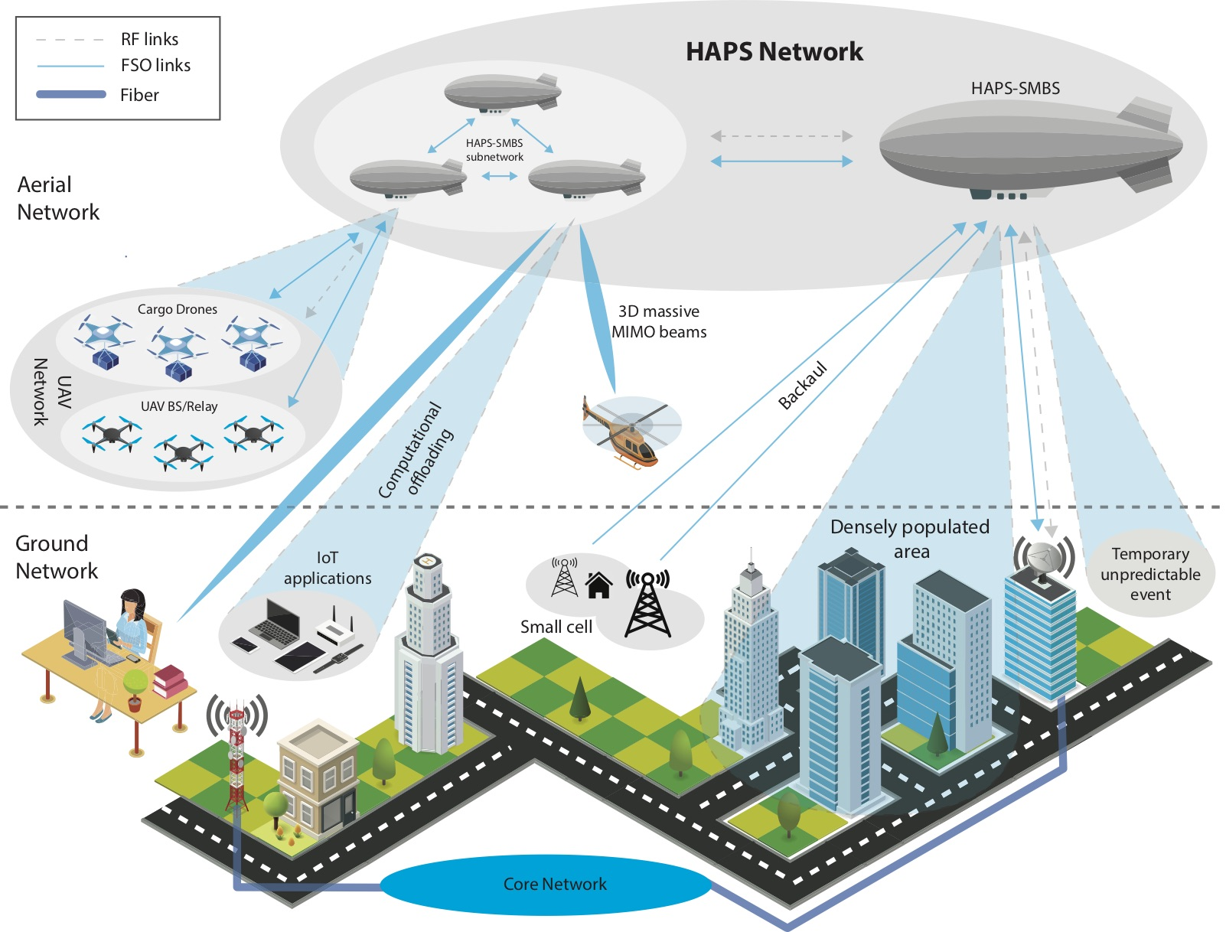
VHetNet: Integrated Terrestrial BSs & HAPS BSs in Urban Areas

Slide 11
Stratobus by Thales Alenia Space
Started in 2010
Length = 140 m; diameter = 33 m
Flight duration = one year
Payload = 450 kg
8 kW
Flight demonstration = 2023+

Slide 12

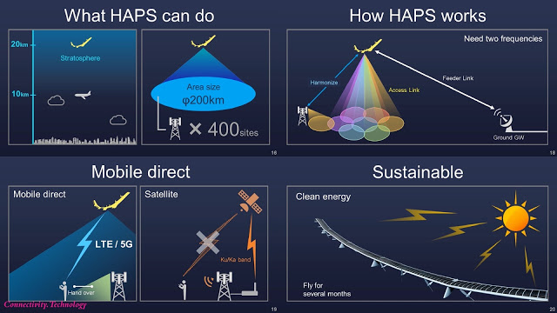
Sunglider by HAPSMobile
(Softbank)
Started in 2017
Wingspan = 78 m
Flight duration = several months
Battery = High energy density Li-ion
Deployment = 2023+

Slide 13
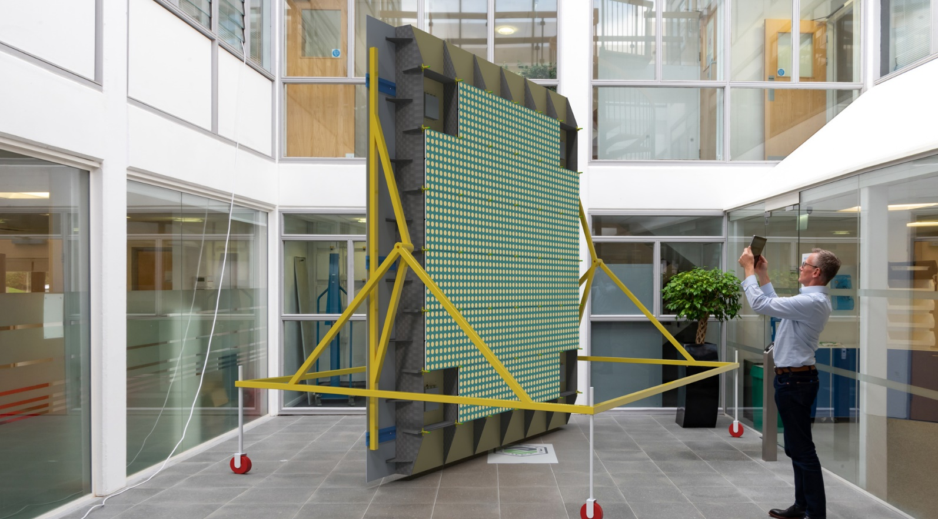
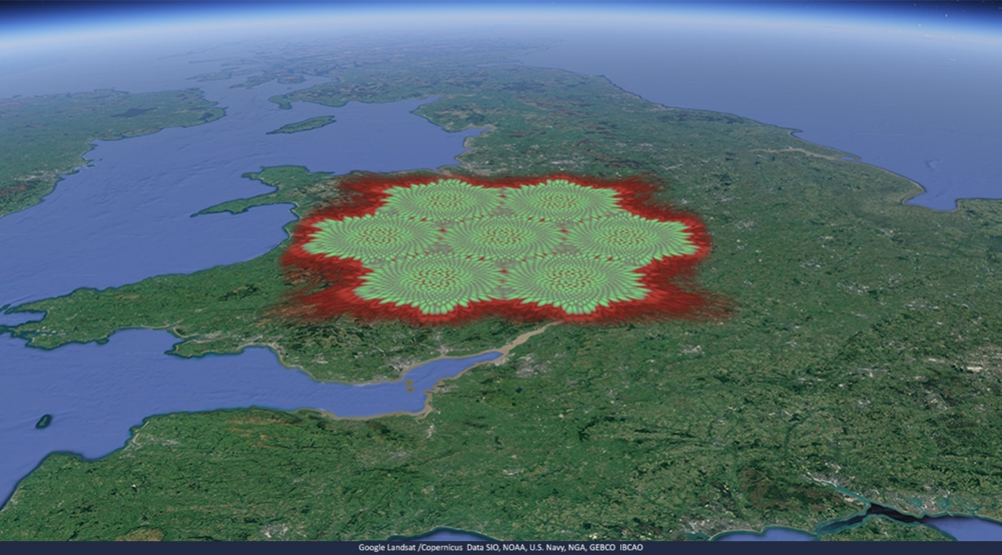

State of the Art: Cambridge Consultants + SPL (Deutsche Telekom)
Started in late 2010s
Antenna: 3 m², 120 kg
480 individually steerable beams
Total capacity > 100 Gbps
Target: 2024

Slide 14
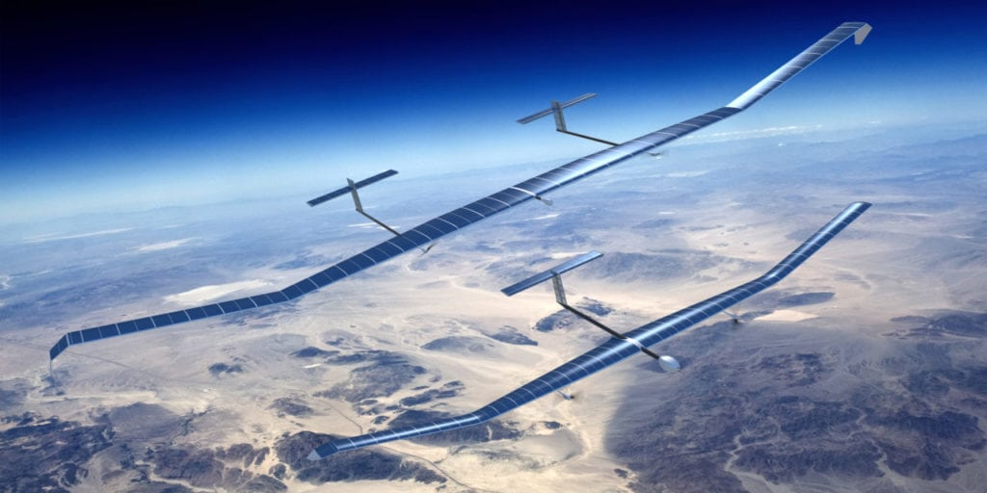

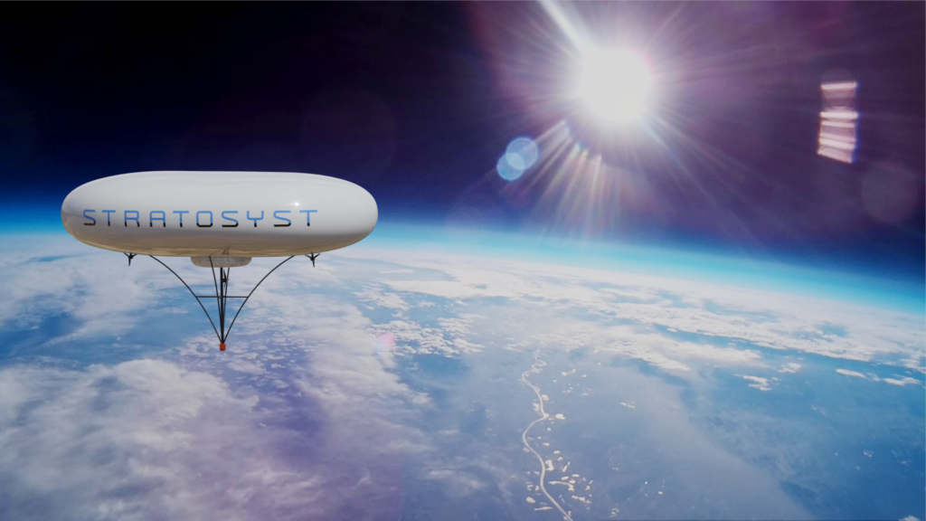
HAPS: Late 2020s (5G Era) – Deployments in rural & remote regions – Fixed-wing aircrafts and airships

Slide 15
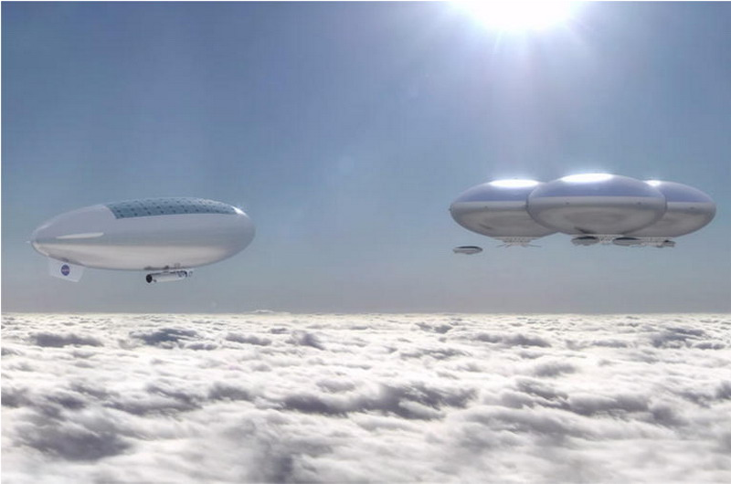


HAPS: 2030s and beyond (6G | B6G Era) – Deployments in metro (dense urban & suburban) regions – ISS-size aircrafts and airships

Slide 16


HAPS: Perfect fit for ultra massive MIMO (umMIMO)
Dynamic beamforming with dense reuse
Centralized and maneuverable massive capacity → ultra-agile RAN

Slide 17
HAPS: Perfect fit for ultra massive MIMO (umMIMO)
Dynamic beamforming with dense reuse
Centralized and maneuverable massive capacity → ultra-agile RAN
10 GHz x 4 b/s/Hz x 250 reuse (1000 beams) = 10 Tbps

Slide 18
HAPS: Perfect fit for ultra massive MIMO (umMIMO)
Dynamic beamforming with dense reuse
Centralized and maneuverable massive capacity → ultra-agile RAN
10 GHz x 4 b/s/Hz x 250 reuse (1000 beams) = 10 Tbps
10 GHz x 4 b/s/Hz x 2500 reuse (10,000 beams) = 100 Tbps

Slide 19
0.2º beamwidth →
70 m diameter hotspot

Slide 20
0.2º beamwidth →
70 m diameter hotspot

Slide 21
0.2º beamwidth →
70 m diameter hotspot

Slide 22
0.2º beamwidth →
70 m diameter hotspot

Slide 23



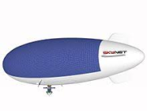








HAPS Constellations of the Future in Urban Areas
Distributed ultra massive MIMO
Integrated communications,
computing, sensing, navigation,
positioning
Distributed data centre
Caching, MEC, sensing
Access + transport + core
5G/6G/7G air-interface
5G BS: 11.5 kW
2030s HAPS: x10
Nuclear power?
Remote charging?
Tethering to ground?
Lithium-ion batteries?
Fluoride-ion batteries?
Battery replacement?
LEO FSO for backhaul

Slide 24
HAPS Networks Research @ Carleton: Concept and Vision Papers 2021
S. Alfattani, W. Jaafar, Y. Hmamouche, H. Yanikomeroglu, A. Yongacoglu, N.D. Dao, P. Zhu, “Aerial platforms with reconfigurable smart surfaces for 5G and beyond”, IEEE Communications Magazine, Jan 2021. [ieeexplore.ieee.org/document/9356531]
S. Alam, G. Karabulut Kurt, H. Yanikomeroglu, N.D. Dao, P. Zhu, “High altitude platform station based super macro base station constellations”, IEEE Communications Magazine, Jan 2021. [ieeexplore.ieee.org/document/9356529]
G. Kurt, M.G. Khoshkholgh, S. Alfattani, A. Ibrahim, T.S.J. Darwish, Md S. Alam, H. Yanikomeroglu, A. Yongacoglu, “A vision and framework for the high altitude platform station (HAPS) networks of the future”, IEEE Communications Surveys and Tutorials, Q2 2021. [ieeexplore.ieee.org/document/9380673]
T. Darwish, G. Karabulut Kurt, H. Yanikomeroglu, G. Senarath, P. Zhu, “A vision of self-evolving network management for future intelligent vertical HetNet”, IEEE Wireless Communications Magazine, Aug 2021. [ieeexplore.ieee.org/document/9535454]
G. Karabulut Kurt, H. Yanikomeroglu, “Communication, computing, caching, and sensing for next generation aerial delivery networks: Using a high-altitude platform station as an enabling technology ”, IEEE Vehicular Technology Magazine, Sep 2021. [ieeexplore.ieee.org/document/9462712]
N. Cherif, W. Jaafar, H. Yanikomeroglu, A. Yongacoglu, “3D Aerial highways: The key enabler of the retail industry transformation”, IEEE Communications Magazine, Sep 2021. [arxiv.org/abs/2009.09477]
W. Jaafar, H. Yanikomeroglu, “HAPS-ITS: Enabling future ITS services in trans-continental highways”, under review in IEEE Communications Magazine. [arxiv.org/abs/2105.04756]
https://www.youtube.com/channel/UCE7CGxWVxDbRFJUO-inSDOA
halim@sce.carleton.ca
Notes:
24

